Slide 1
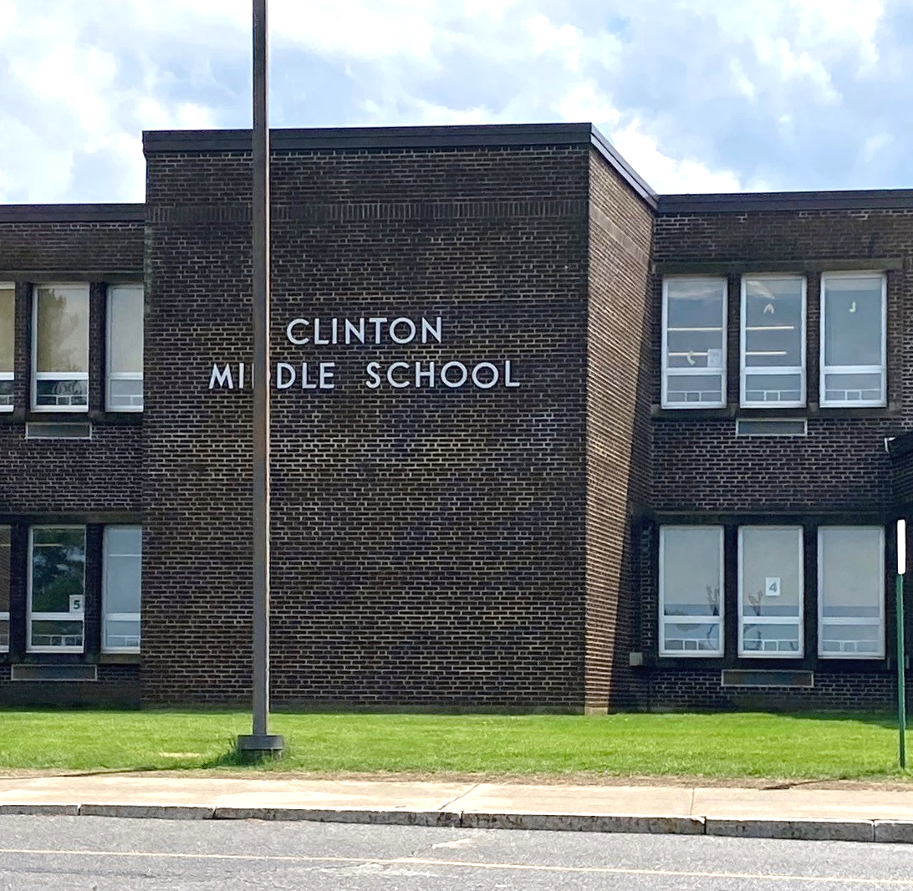
Clinton Middle School Project
School Building Committee Meeting #1
August 9, 6:30 PM - Remote Meeting

Slide 2
SBC Meeting Agenda – August 9, 2022, 6:30PM Remote
Call to Order
Approval of Minutes:
  Previous SBC Meeting Minutes. Vote Expected.
Invoices and commitments Submitted for Approval:
  Invoices may be submitted in the meeting for approval by the SBC
  Contract Approval
Introduction of the OPM, Dore & Whittier Management Partners team
Owner Approval Process
  Financial Approvals
  Discussion on working groups, focus group, advisory group to the SBC
  Education focus group – Education Program Development
  Executive advisory group
  Community outreach advisory group
  Facilities focus group
Communication Protocol
  Project web site - File Sharing and website reporting
SBC Goals –
  Handout (explaining the process)
Draft Schedule
  Through Schematic Design
SBC Meeting Schedule, Formats, Invitations
  Format review – in person or remote
  Meeting preparation and information sharing
Pro-pay System and monthly reporting access
Architect RFS Review:
  RFS review and MSBA selection process overview
  Vote to send the RFS to the MSBA for their review
Architect Selection Committee:
  3 Representatives to represent the district at the MSBA Designer Selection Panel in Boston – (includes one member designated by the school committee, the superintendent of schools or his/her designee and the chief executive officer of the city or town or his/her designee.)
Other Topics not Reasonably Anticipated 48 hours prior to the Meeting
Public Comment
Next Meetings
Adjourn

Slide 3
Previous SBC Minutes approval, vote expected

Slide 4
SBC Meeting Agenda – August 9, 2022, 6:30PM Remote
Call to Order
Approval of Minutes:
  Previous SBC Meeting Minutes. Vote Expected.
Invoices and commitments Submitted for Approval:
  Invoices may be submitted in the meeting for approval by the SBC
  Contract Approval
Introduction of the OPM, Dore & Whittier Management Partners team
Owner Approval Process
  Financial Approvals
  Discussion on working groups, focus group, advisory group to the SBC
  Education focus group – Education Program Development
  Executive advisory group
  Community outreach advisory group
  Facilities focus group
Communication Protocol
  Project web site - File Sharing and website reporting
SBC Goals –
  Handout (explaining the process)
Draft Schedule
  Through Schematic Design
SBC Meeting Schedule, Formats, Invitations
  Format review – in person or remote
  Meeting preparation and information sharing
Pro-pay System and monthly reporting access
Architect RFS Review:
  RFS review and MSBA selection process overview
  Vote to send the RFS to the MSBA for their review
Architect Selection Committee:
  3 Representatives to represent the district at the MSBA Designer Selection Panel in Boston – (includes one member designated by the school committee, the superintendent of schools or his/her designee and the chief executive officer of the city or town or his/her designee.)
Other Topics not Reasonably Anticipated 48 hours prior to the Meeting
Public Comment
Next Meetings
Adjourn

Slide 5
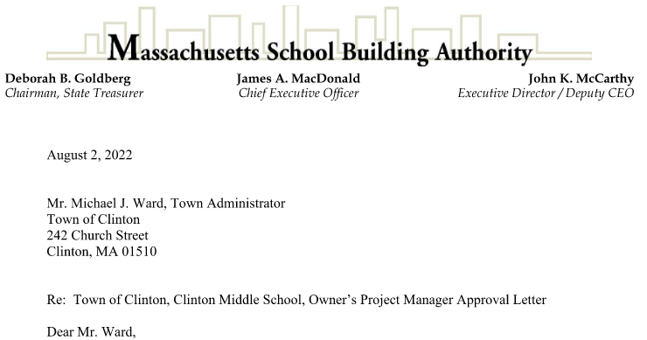
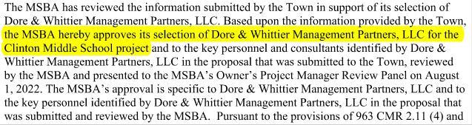
MSBA Contract Approval to select D&W as the OPM
“A section of the approval letter to the Town of Clinton”

Slide 6
SBC Meeting Agenda – August 9, 2022, 6:30PM Remote
Call to Order
Approval of Minutes:
  Previous SBC Meeting Minutes. Vote Expected.
Invoices and commitments Submitted for Approval:
  Invoices may be submitted in the meeting for approval by the SBC
  Contract Approval
Introduction of the OPM, Dore & Whittier Management Partners team
Owner Approval Process
  Financial Approvals
  Discussion on working groups, focus group, advisory group to the SBC
  Education focus group – Education Program Development
  Executive advisory group
  Community outreach advisory group
  Facilities focus group
Communication Protocol
  Project web site - File Sharing and website reporting
SBC Goals –
  Handout (explaining the process)
Draft Schedule
  Through Schematic Design
SBC Meeting Schedule, Formats, Invitations
  Format review – in person or remote
  Meeting preparation and information sharing
Pro-pay System and monthly reporting access
Architect RFS Review:
  RFS review and MSBA selection process overview
  Vote to send the RFS to the MSBA for their review
Architect Selection Committee:
  3 Representatives to represent the district at the MSBA Designer Selection Panel in Boston – (includes one member designated by the school committee, the superintendent of schools or his/her designee and the chief executive officer of the city or town or his/her designee.)
Other Topics not Reasonably Anticipated 48 hours prior to the Meeting
Public Comment
Next Meetings
Adjourn

Slide 7
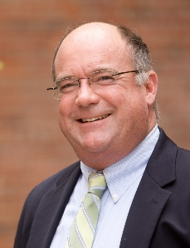

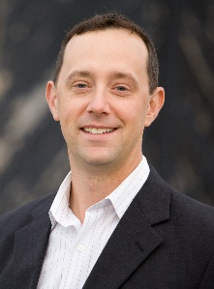

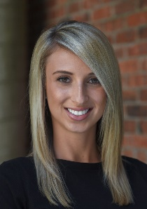
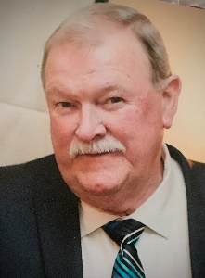

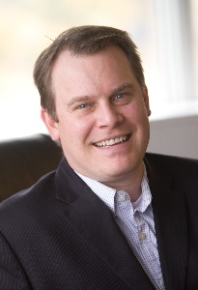
D&W Core Team + In-House Resources
Trip Elmore
Project Director
Mike Burton
Partner in Charge
Steve Brown
Project Executive
Michael Cox
Project Manager - Controls
Rachel Rincon
Assistant Project Manager
Larry Erekson
On-Site Project Representative
Dave Mentzer
Code Review & Sustainability
Jason Boone
Ed Programming Review
Peter Bradley
PM&C
Cost Estimating
Albert R. Russell, Architect
Design Review
Victor Verma
RSV Assoc.
Structural Peer Review
Notes:
Mike

Slide 8
SBC Meeting Agenda – August 9, 2022, 6:30PM Remote
Call to Order
Approval of Minutes:
  Previous SBC Meeting Minutes. Vote Expected.
Invoices and commitments Submitted for Approval:
  Invoices may be submitted in the meeting for approval by the SBC
  Contract Approval
Introduction of the OPM, Dore & Whittier Management Partners team
Owner Approval Process
  Financial Approvals
  Discussion on working groups, focus group, advisory group to the SBC
  Education focus group – Education Program Development
  Executive advisory group
  Community outreach advisory group
  Facilities focus group
Communication Protocol
  Project web site - File Sharing and website reporting
SBC Goals –
  Handout (explaining the process)
Draft Schedule
  Through Schematic Design
SBC Meeting Schedule, Formats, Invitations
  Format review – in person or remote
  Meeting preparation and information sharing
Pro-pay System and monthly reporting access
Architect RFS Review:
  RFS review and MSBA selection process overview
  Vote to send the RFS to the MSBA for their review
Architect Selection Committee:
  3 Representatives to represent the district at the MSBA Designer Selection Panel in Boston – (includes one member designated by the school committee, the superintendent of schools or his/her designee and the chief executive officer of the city or town or his/her designee.)
Other Topics not Reasonably Anticipated 48 hours prior to the Meeting
Public Comment
Next Meetings
Adjourn

Slide 9
Does the Clinton SBC want to engage “Working Groups” to advise the committee as a whole?
Clinton SBC – Workgroup descriptions 8-9-22
The potential / proposed work groups list below illustrates options for the SBC to organize in a non-public meeting forum to investigate issues and make a recommendation to the SBC, before a SBC vote or action is taken. There is no requirement to have a “Workgroup” organization or structure, this is simply an option presented for consideration if the members of the SBC want more time to study segments of the process. Examples of “potential working groups” are listed below.
  Education programming and learning technology –
  Existing Facilities assessment –
  Public relations/information sharing -
  Financial review –
  Green buildings and sustainability initiatives -
  Interior design-
  Exterior design/Landscaping-
  Resident / community facility use-
  Site logistics and phased occupancy-

Slide 10
SBC Meeting Agenda – August 9, 2022, 6:30PM Remote
Call to Order
Approval of Minutes:
  Previous SBC Meeting Minutes. Vote Expected.
Invoices and commitments Submitted for Approval:
  Invoices may be submitted in the meeting for approval by the SBC
  Contract Approval
Introduction of the OPM, Dore & Whittier Management Partners team
Owner Approval Process
  Financial Approvals
  Discussion on working groups, focus group, advisory group to the SBC
  Education focus group – Education Program Development
  Executive advisory group
  Community outreach advisory group
  Facilities focus group
Communication Protocol
  Project web site - File Sharing and website reporting
SBC Goals –
  Handout (explaining the process)
Draft Schedule
  Through Schematic Design
SBC Meeting Schedule, Formats, Invitations
  Format review – in person or remote
  Meeting preparation and information sharing
Pro-pay System and monthly reporting access
Architect RFS Review:
  RFS review and MSBA selection process overview
  Vote to send the RFS to the MSBA for their review
Architect Selection Committee:
  3 Representatives to represent the district at the MSBA Designer Selection Panel in Boston – (includes one member designated by the school committee, the superintendent of schools or his/her designee and the chief executive officer of the city or town or his/her designee.)
Other Topics not Reasonably Anticipated 48 hours prior to the Meeting
Public Comment
Next Meetings
Adjourn

Slide 11
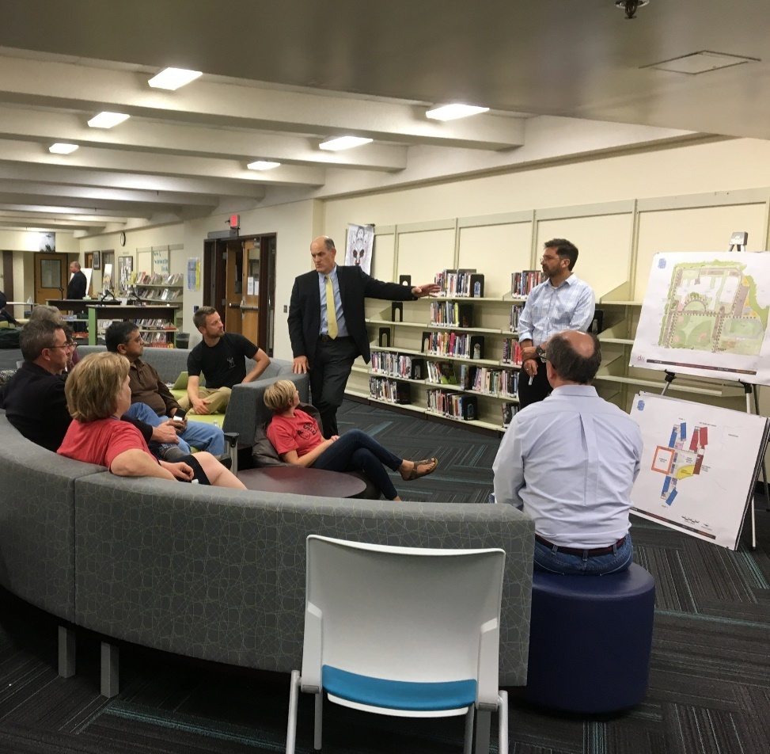

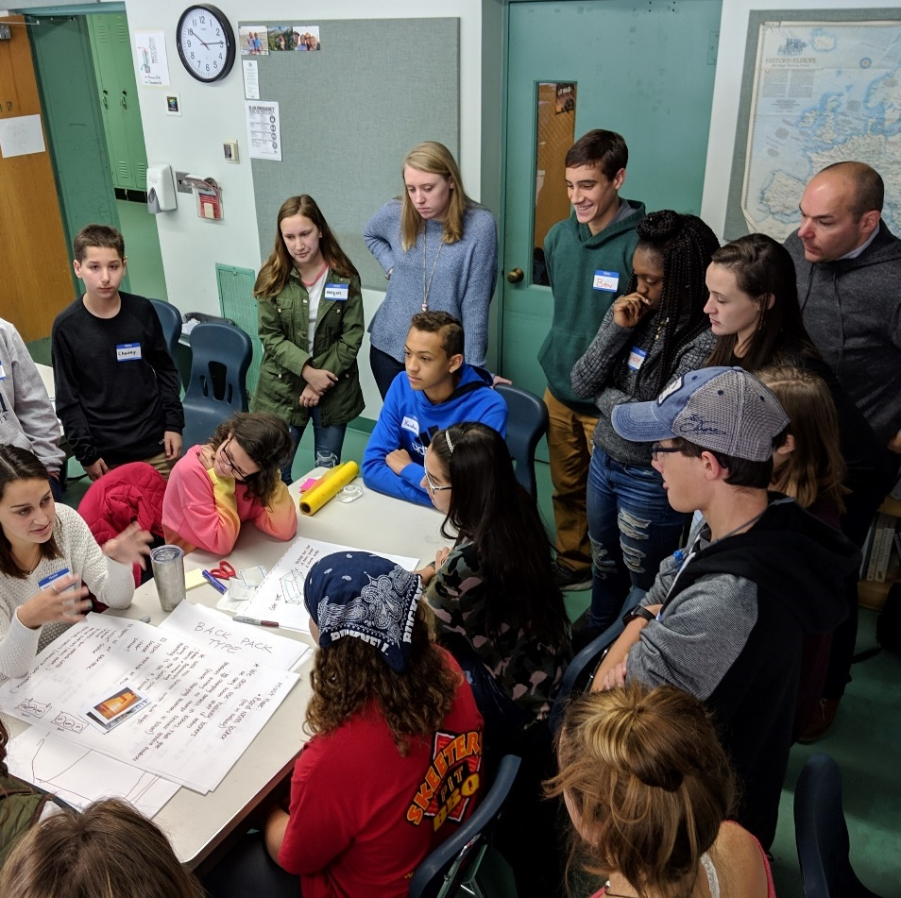
Community Engagement
build trust
share the facts
gain support
Notes:
Rachel

Slide 12
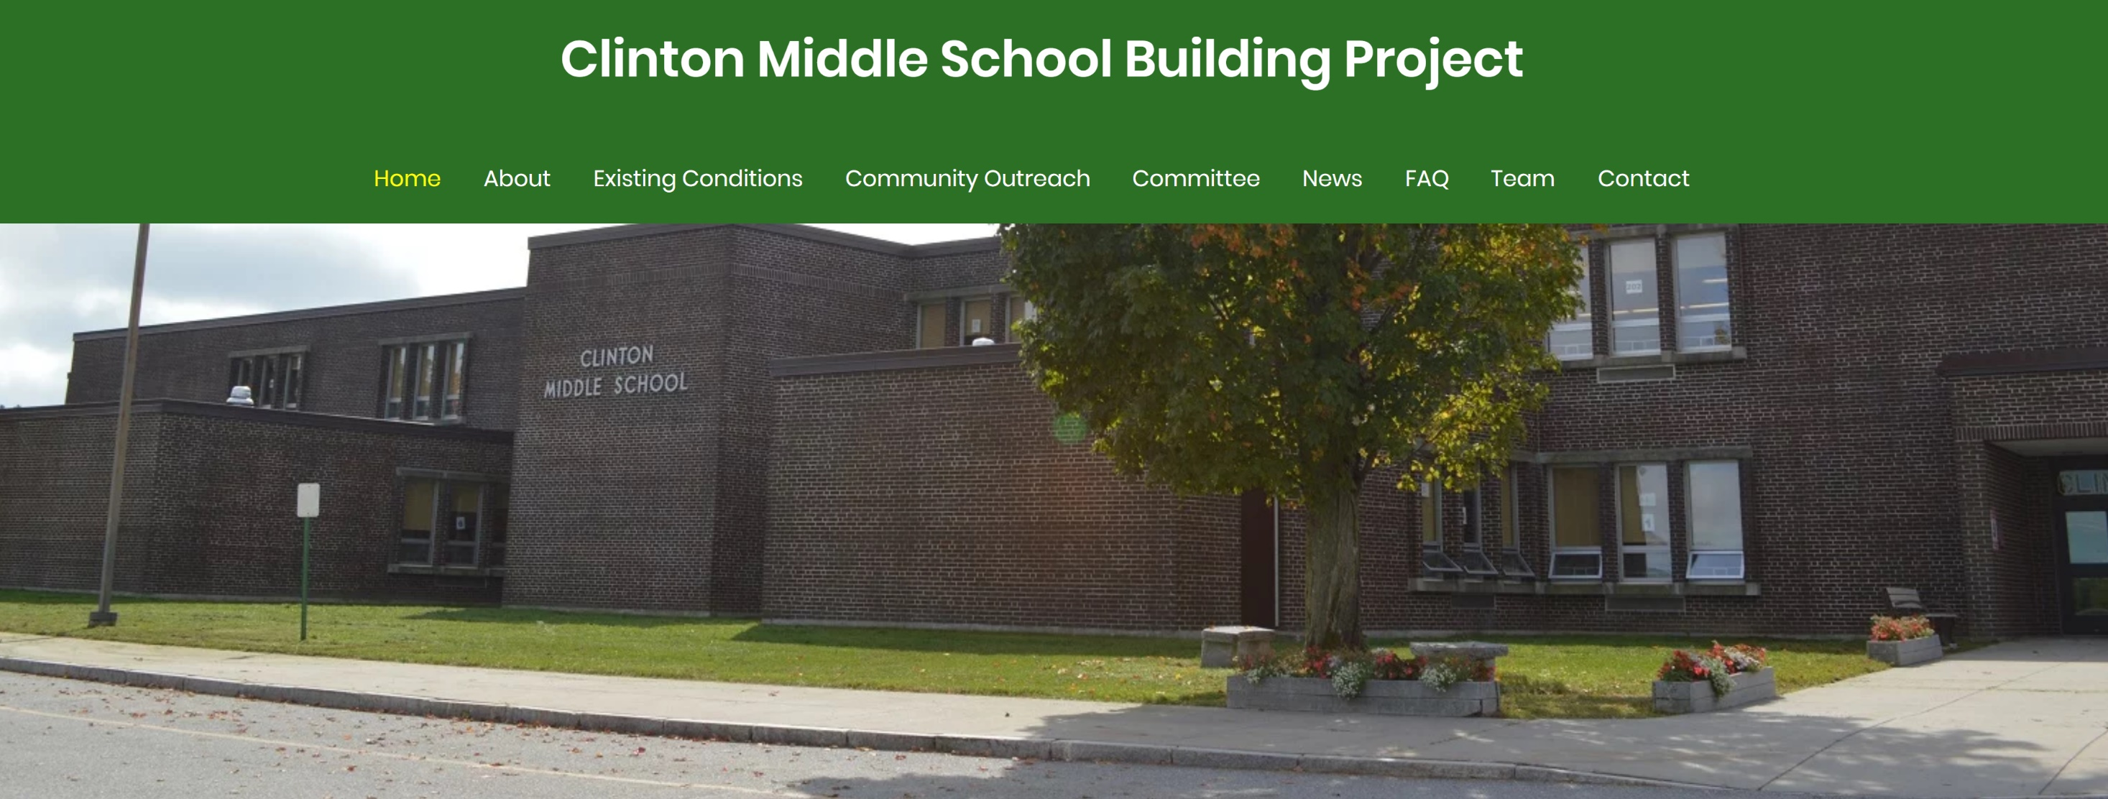


Notes:
Rachel

Slide 13
Defining the “Goals for the Project”
Step 1 – Project Goals
  Ensure the fair representations of the school district and the community at large during the decision-making process. Also, be transparent and actively and frequently engage and inform all stake holders.
Step 2 – Gathering SBC Member Project Goals
  Questionnaire
Step 3 – Combining SBC Member Project Goals
  Compile responses
Step 4 – Creating Project Goals Statements
  Example: “The goal of the Mount Greylock Building Project as set forth by the School Building Committee is a well-designed, site-specific project that supports the educational program; creates collaborative, flexible spaces; and incorporates technology for continuing the educational excellence.
Step 5 – Publishing the Project Goals on the Website

Slide 14
Goals
“Designing/building a school that meets the needs of the district and the taxpayers.”
“Educational program for students -- innovative and current to prepare students for a dynamic and ever-changing world”
“Budget, sustainability (maintenance and green construction) and a final product that will be serviceable, both physically and programmatically, for many years.”
“Being proactive on budget management and communications. Ensuring quality construction. Sensitivity to needs of multiple constituencies. Timely follow up from partners (OPM, Designer, Contractor). Detailed record keeping.”
“Design and cost are the two top items of most importance. Because of the constrained site conditions, the building layout and configuration are or paramount concern to assure the mandates of the Ed program are met.”
“To strike a compromise: between program and cost; energy efficiency and simplicity; design and pragmatism.”
“Cost efficiency -- the Essex Elementary School will be next so both towns have to see that this can be done within a reasonable budget and in a way that does not prevent/preclude or substantially delay a future redo of EES”
“21st Century learning, architecture conducive to learning and collaboration, cost efficiency, scheduling”
“A building designed to support 21st century learning, a building process that is sensitive to the needs of the current school while in operation, flexibility of design (ie. grade level configurations can change from year to year), traffic flow/patterns, parking, etc.”
“Building what we need (not more than we need), on time and on budget; Ensuring that design meets educational needs; Ensuring that we go to the towns knowing that we will get a YES vote for Construction”
“Excellence of the overall project, resolving any political differences between Essex and Manchester regarding cost, keeping the existing auditorium, not reducing size of the existing gymnasium”
“Balance! I want a good learning environment for students and staff that does not cost so much it is called Taj Mahal.”

Slide 15
SBC Meeting Agenda – August 9, 2022, 6:30PM Remote
Call to Order
Approval of Minutes:
  Previous SBC Meeting Minutes. Vote Expected.
Invoices and commitments Submitted for Approval:
  Invoices may be submitted in the meeting for approval by the SBC
  Contract Approval
Introduction of the OPM, Dore & Whittier Management Partners team
Owner Approval Process
  Financial Approvals
  Discussion on working groups, focus group, advisory group to the SBC
  Education focus group – Education Program Development
  Executive advisory group
  Community outreach advisory group
  Facilities focus group
Communication Protocol
  Project web site - File Sharing and website reporting
SBC Goals –
  Handout (explaining the process)
Draft Schedule
  Through Schematic Design
SBC Meeting Schedule, Formats, Invitations
  Format review – in person or remote
  Meeting preparation and information sharing
Pro-pay System and monthly reporting access
Architect RFS Review:
  RFS review and MSBA selection process overview
  Vote to send the RFS to the MSBA for their review
Architect Selection Committee:
  3 Representatives to represent the district at the MSBA Designer Selection Panel in Boston – (includes one member designated by the school committee, the superintendent of schools or his/her designee and the chief executive officer of the city or town or his/her designee.)
Other Topics not Reasonably Anticipated 48 hours prior to the Meeting
Public Comment
Next Meetings
Adjourn

Slide 16
Administering a Transparent Process
LOCAL OFFICIALS & STAKEHOLDERS
VOTERS MUST BE INFORMED
Submit SOI
Submit CD Package
Submit SD Package
Submit DD Package
Designer Selection
270 days
OPM Selection
Submit PDP
Submit PSR
120 days
1
2
$
$
$
$
$
3
4
5
6
7
8
BOD
BOD
COMMUNITY MEETINGS
Eligibility
Form
Project
Team
Feasibility
Schematic
Design
Funding
The
Project
Detailed
Design
Construction
Closeout
Approval of
Preferred Solution
Project Funding
Agreement
Educational Program
Notes:
Trip

Slide 17
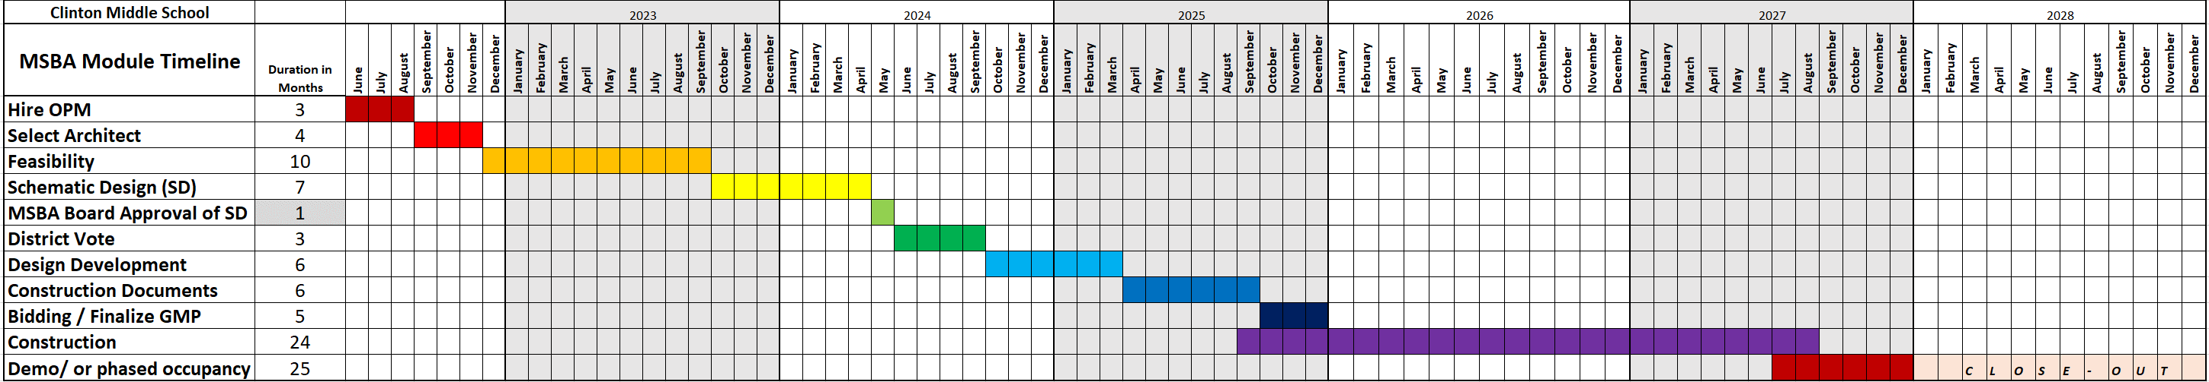
CMS MSBA Module Schedule
Notes:
Trip

Slide 18
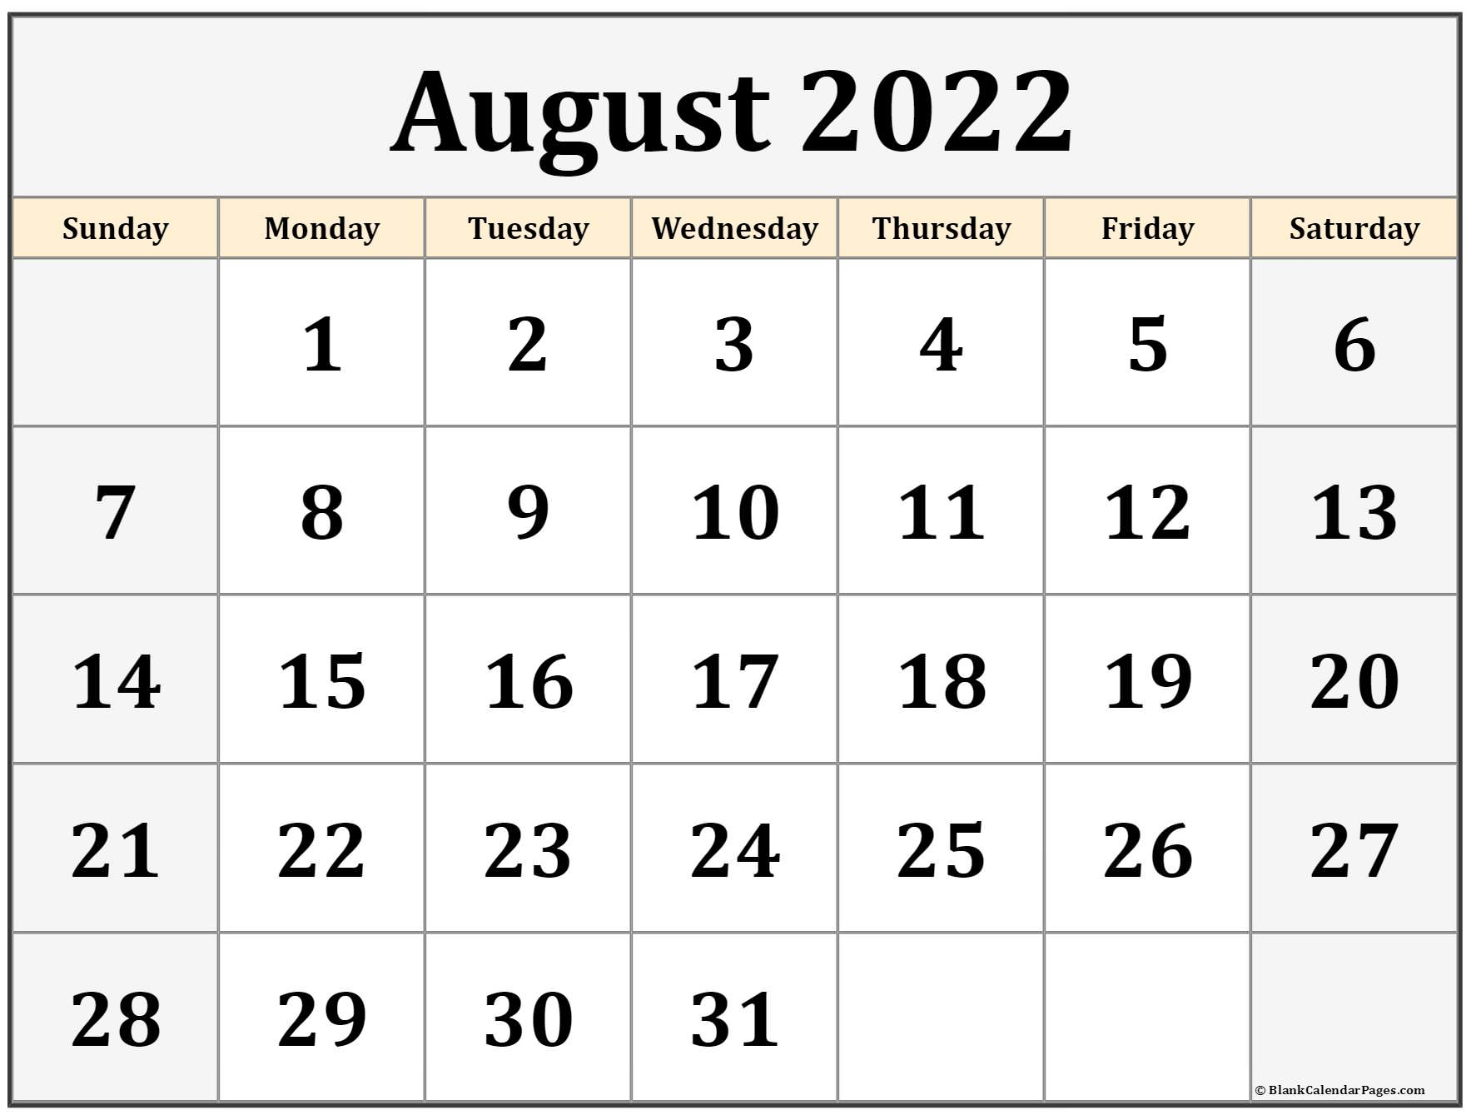
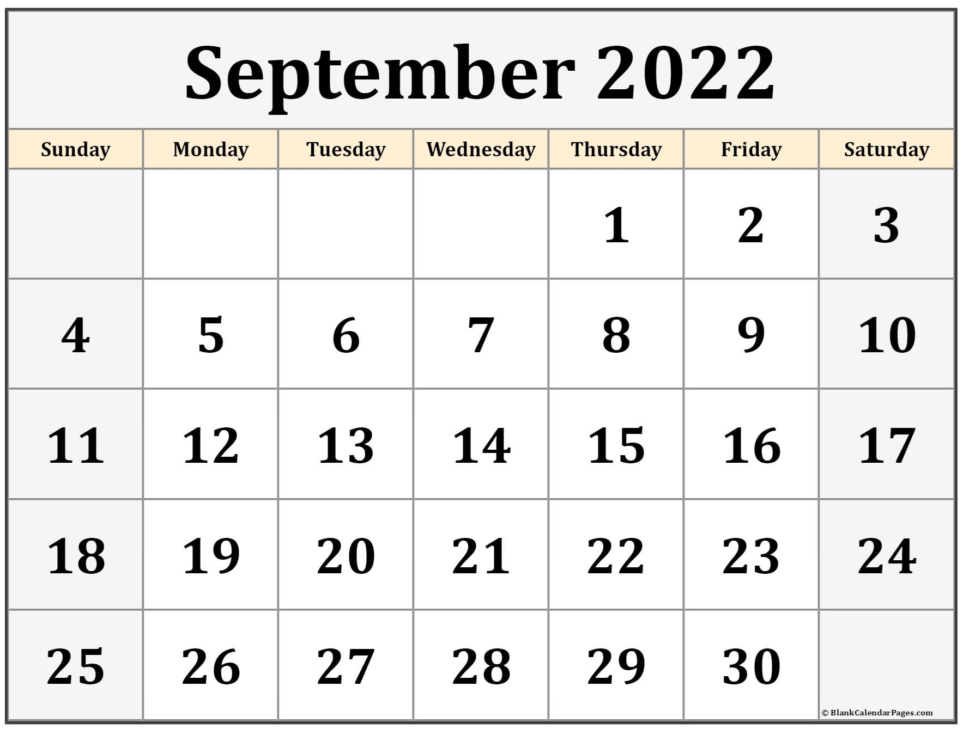
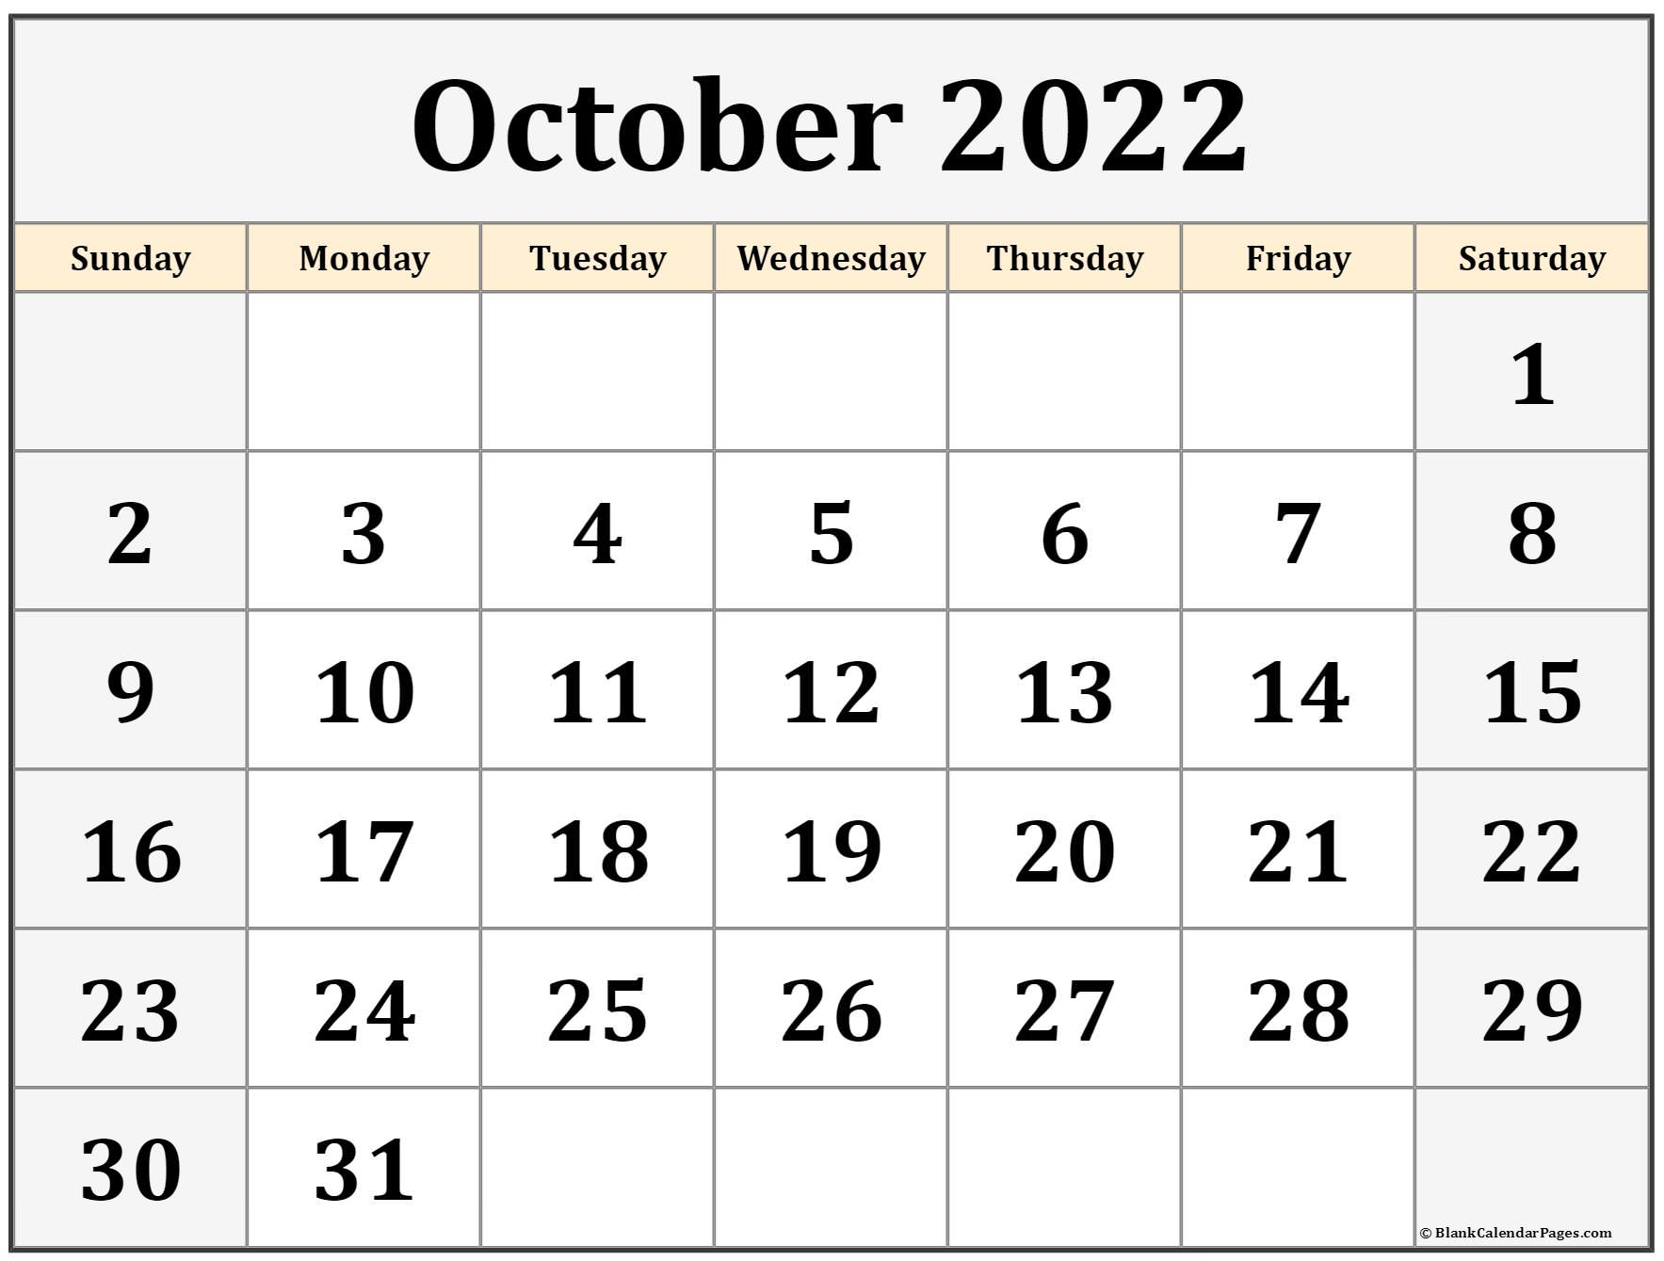
Regular SBC Meetings
Proposed SBC Meeting(s)
Target Designer Selection Panel Meeting (DSP)

Slide 19
SBC Meeting Agenda – August 9, 2022, 6:30PM Remote
Call to Order
Approval of Minutes:
  Previous SBC Meeting Minutes. Vote Expected.
Invoices and commitments Submitted for Approval:
  Invoices may be submitted in the meeting for approval by the SBC
  Contract Approval
Introduction of the OPM, Dore & Whittier Management Partners team
Owner Approval Process
  Financial Approvals
  Discussion on working groups, focus group, advisory group to the SBC
  Education focus group – Education Program Development
  Executive advisory group
  Community outreach advisory group
  Facilities focus group
Communication Protocol
  Project web site - File Sharing and website reporting
SBC Goals –
  Handout (explaining the process)
Draft Schedule
  Through Schematic Design
SBC Meeting Schedule, Formats, Invitations
  Format review – in person or remote
  Meeting preparation and information sharing
Pro-pay System and monthly reporting access
Architect RFS Review:
  RFS review and MSBA selection process overview
  Vote to send the RFS to the MSBA for their review
Architect Selection Committee:
  3 Representatives to represent the district at the MSBA Designer Selection Panel in Boston – (includes one member designated by the school committee, the superintendent of schools or his/her designee and the chief executive officer of the city or town or his/her designee.)
Other Topics not Reasonably Anticipated 48 hours prior to the Meeting
Public Comment
Next Meetings
Adjourn

Slide 20
Propay Submission
Procedure
Procedural steps for submitting MSBA propay reimbursement requests after project invoices have been reviewed and approved by both Dore + Whittier and Clinton school building committee
Invoice’s to include; project team costs (OPM/Designer/Contractor) and district costs (i.e. project administration cost)
Step 1: Dore + Whittier submits approved monthly project invoices for payment by Clinton along with Propay summary sheet for record (see attached example)
Step 2: Clinton processes invoices for payment via warrant process
Step 3: Once invoices are applied to a warrant number, Clinton issues warrant confirmation print out to Dore + Whittier for Propay processing (warrant number and date are required to make submission)
Step 3: Dore + Whittier enters invoices into propay and issues 3010, 3011, 3012, 3013 and 3014 for district signature.
Step 4: Dore and Whittier submits signed reimbursement request (with copy of associated invoices) to MSBA (electrically and USPS)

Slide 21
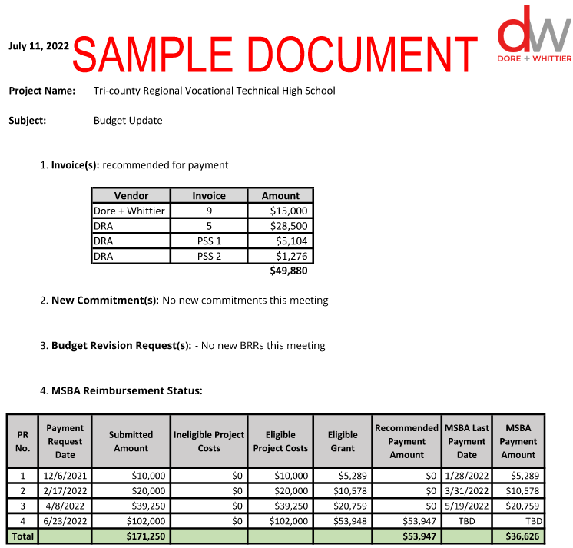
Monthly Cost Reporting

Slide 22
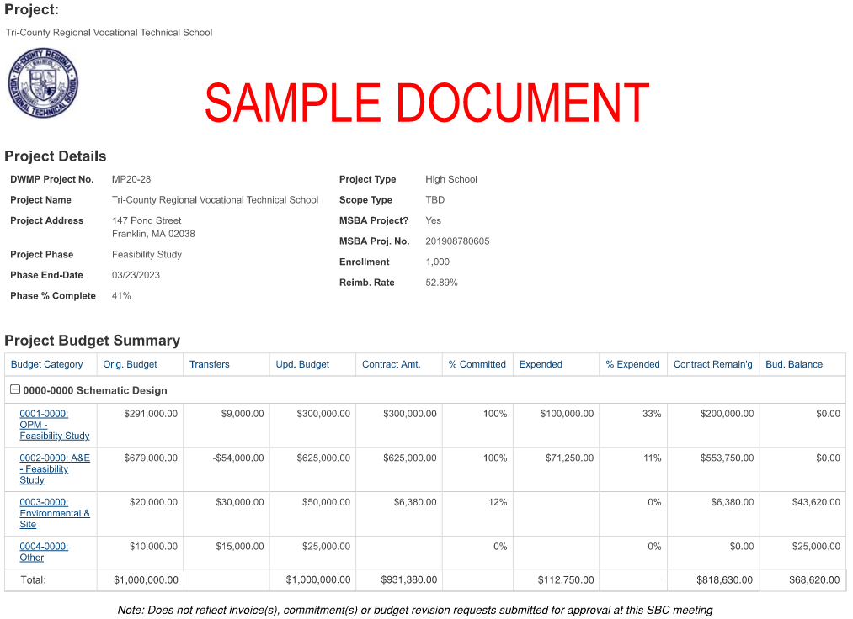
Budget Tracking

Slide 23
SBC Meeting Agenda – August 9, 2022, 6:30PM Remote
Call to Order
Approval of Minutes:
  Previous SBC Meeting Minutes. Vote Expected.
Invoices and commitments Submitted for Approval:
  Invoices may be submitted in the meeting for approval by the SBC
  Contract Approval
Introduction of the OPM, Dore & Whittier Management Partners team
Owner Approval Process
  Financial Approvals
  Discussion on working groups, focus group, advisory group to the SBC
  Education focus group – Education Program Development
  Executive advisory group
  Community outreach advisory group
  Facilities focus group
Communication Protocol
  Project web site - File Sharing and website reporting
SBC Goals –
  Handout (explaining the process)
Draft Schedule
  Through Schematic Design
SBC Meeting Schedule, Formats, Invitations
  Format review – in person or remote
  Meeting preparation and information sharing
Pro-pay System and monthly reporting access
Architect RFS Review:
  RFS review and MSBA selection process overview
  Vote to send the RFS to the MSBA for their review
Architect Selection Committee:
  3 Representatives to represent the district at the MSBA Designer Selection Panel in Boston – (includes one member designated by the school committee, the superintendent of schools or his/her designee and the chief executive officer of the city or town or his/her designee.)
Other Topics not Reasonably Anticipated 48 hours prior to the Meeting
Public Comment
Next Meetings
Adjourn

Slide 24
Draft Designer RFS
(Continues for 12 pages)

Slide 25
Vote to have the OPM submit the Designer RFS
“Motion to have D&W submit the designer RFS to the MSBA for their review and comment, by___________________,
the motion is 2nd by __________________.
Discussion:
Roll call vote by the representatives appointed by the Board of Selectmen”
Chris McGown - yes___, no___, abstain____
Mike Moran - yes___, no___, abstain____
Mike Ward - yes___, no___, abstain____
Steve Meyer - yes___, no___, abstain____
Tim O’Toole - yes___, no___, abstain____
Brian Delorey - yes___, no___, abstain____
Chris Magliozzi - yes___, no___, abstain____

Slide 26
SBC Meeting Agenda – August 9, 2022, 6:30PM Remote
Call to Order
Approval of Minutes:
  Previous SBC Meeting Minutes. Vote Expected.
Invoices and commitments Submitted for Approval:
  Invoices may be submitted in the meeting for approval by the SBC
  Contract Approval
Introduction of the OPM, Dore & Whittier Management Partners team
Owner Approval Process
  Financial Approvals
  Discussion on working groups, focus group, advisory group to the SBC
  Education focus group – Education Program Development
  Executive advisory group
  Community outreach advisory group
  Facilities focus group
Communication Protocol
  Project web site - File Sharing and website reporting
SBC Goals –
  Handout (explaining the process)
Draft Schedule
  Through Schematic Design
SBC Meeting Schedule, Formats, Invitations
  Format review – in person or remote
  Meeting preparation and information sharing
Pro-pay System and monthly reporting access
Architect RFS Review:
  RFS review and MSBA selection process overview
  Vote to send the RFS to the MSBA for their review
Architect Selection Committee:
  3 Representatives to represent the district at the MSBA Designer Selection Panel in Boston – (includes one member designated by the school committee, the superintendent of schools or his/her designee and the chief executive officer of the city or town or his/her designee.)
Other Topics not Reasonably Anticipated 48 hours prior to the Meeting
Public Comment
Next Meetings
Adjourn

Slide 27
Selection of 3 Clinton Representatives to join the MSBA “Designer Selection Panel”
“3 Representatives to represent the district at the MSBA Designer Selection Panel in Boston –
includes one member designated by the school committee,
the superintendent of schools or his/her designee and
the chief executive officer of the city or town or his/her designee.”

Slide 28
SBC Meeting Agenda – August 9, 2022, 6:30PM Remote
Call to Order
Approval of Minutes:
  Previous SBC Meeting Minutes. Vote Expected.
Invoices and commitments Submitted for Approval:
  Invoices may be submitted in the meeting for approval by the SBC
  Contract Approval
Introduction of the OPM, Dore & Whittier Management Partners team
Owner Approval Process
  Financial Approvals
  Discussion on working groups, focus group, advisory group to the SBC
  Education focus group – Education Program Development
  Executive advisory group
  Community outreach advisory group
  Facilities focus group
Communication Protocol
  Project web site - File Sharing and website reporting
SBC Goals –
  Handout (explaining the process)
Draft Schedule
  Through Schematic Design
SBC Meeting Schedule, Formats, Invitations
  Format review – in person or remote
  Meeting preparation and information sharing
Pro-pay System and monthly reporting access
Architect RFS Review:
  RFS review and MSBA selection process overview
  Vote to send the RFS to the MSBA for their review
Architect Selection Committee:
  3 Representatives to represent the district at the MSBA Designer Selection Panel in Boston – (includes one member designated by the school committee, the superintendent of schools or his/her designee and the chief executive officer of the city or town or his/her designee.)
Other Topics not Reasonably Anticipated 48 hours prior to the Meeting
Public Comment
Next Meetings
Adjourn

